Slide 1
Detection of Hate Speech using Machine Learning
CSIT598_01SP22 MACHINE LEARNING
By Yamini Pathuri and Koundinya Raghava Nerella
Instructor: Dr. Jing Peng
Montclair State University, NJ

Slide 2

Hate Speech on Social Media Platforms:
One of the serious problems we see with social media platforms is hate speech. We are motivated to use Machine Learning to build a hate-speech detection model. Hate speech is not legally defined because people's opinions cannot easily be considered hateful or offensive. In any case, the UN defines hate speech as any type of verbal, written or behavioral communication that may attack or use discrimination.

Slide 3
Data from twitter:
The dataset we are using here is downloaded from Kaggle. This dataset was originally collected from Twitter and contains the following columns:
index
count
hate_speech
offensive_language
neither
class
tweet

Slide 4
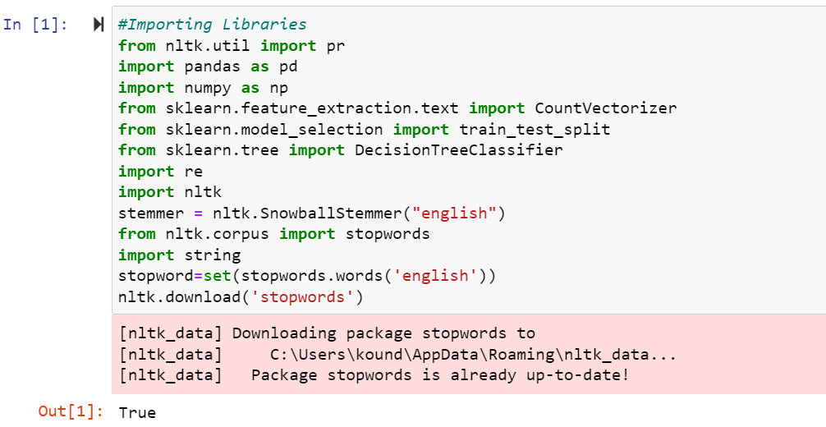
Importing necessary Libraries and dataset:
Let's start by importing all the required Python libraries and the dataset that we need for this task:

Slide 5
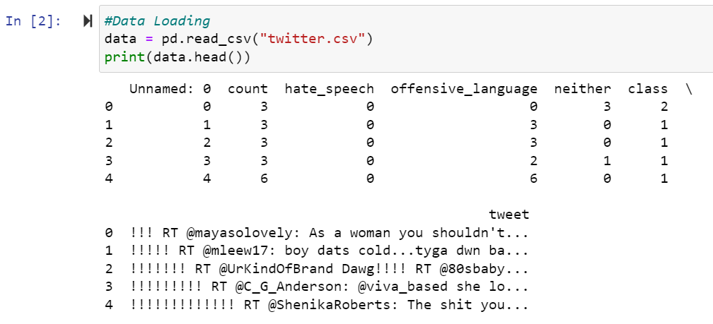
Loading Data:
Let us load the Data that we are going to use, to train our Hate-Speech detection model:

Slide 6
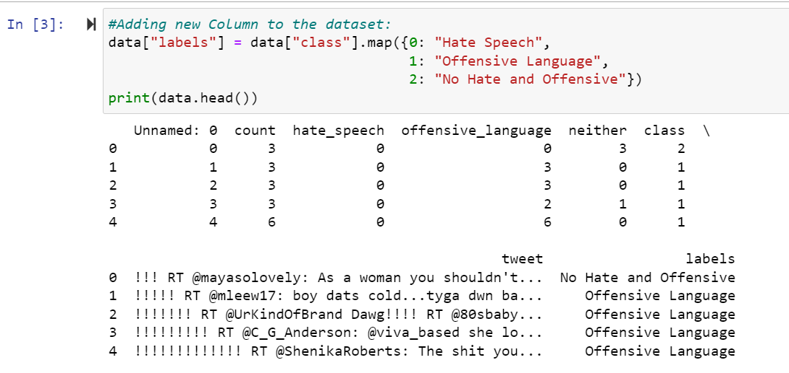
Modifying Dataset:
Adding a new column to this dataset as labels which will contain the values as:
Hate Speech
Offensive Language
No Hate and Offensive

Slide 7
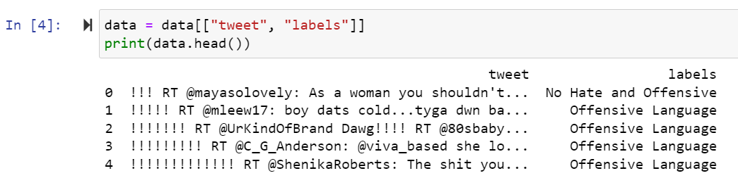
Data Cleansing:
We select only the ‘tweet’ and ‘labels’ columns for the rest of the task of training a hate speech detection model.

Slide 8
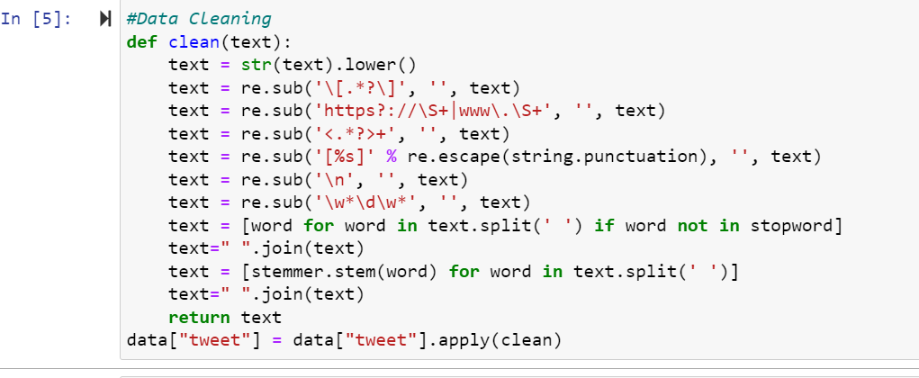
Data Cleansing:
Creating a function to clean the texts in the tweet column:

Slide 9
Trying to build the model with different Vectorizers:
We have tried to build the detection model with two different vectorizers and compare the results to find out the effective vectorizer in this case.
TF-IDF Vectorizer
Count Vectorizer
Splitting Dataset to train with the help of Decision Tree Classifier:
We have split the dataset into training and test sets and train a machine learning model for the task of hate speech detection with the help of decision tree classifier.

Slide 10
Decision Tree Classifier:
Decision Tree algorithm is the type of Supervised Learning algorithms
Decision Tree Classifier is one of the popular Classifier algorithms which can be used to interpret and understand.
Used to solve the problems involved with regressions and classifications
The objective of Decision tree is to generate a training model, that can be used to predict the value or class of the selected variable by learning the simple decision rules which can be assumed from the training data.

Slide 11
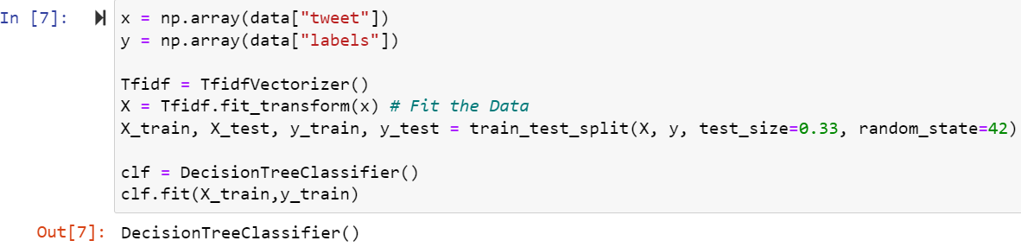
Model with TF-IDF Vectorizer
Using TF-IDF to quantify the importance of each word in a tweet.

Slide 12
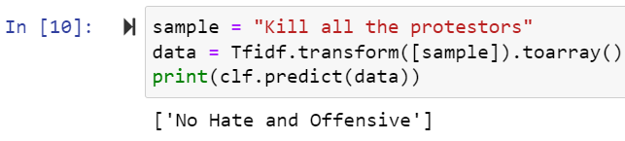
Testing the TF-IDF Model:
From the above sample, it is clearly evident that this model has failed to identify the ‘hate-speech’.

Slide 14
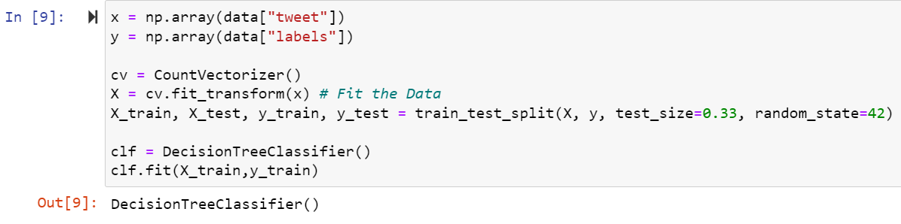
Testing the Count-vectorizer model:
Using the Count-vectorizer to convert the tweets and labels to a Matrix of token accounts.

Slide 15

Testing the Count-vectorizer Model:
Now let’s test this model to see if it detects hate speech or not.

Slide 16
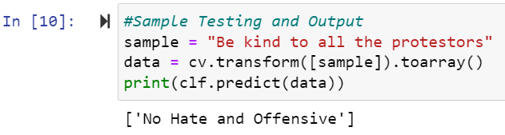
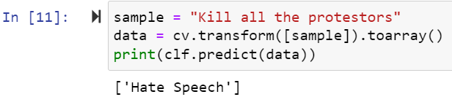
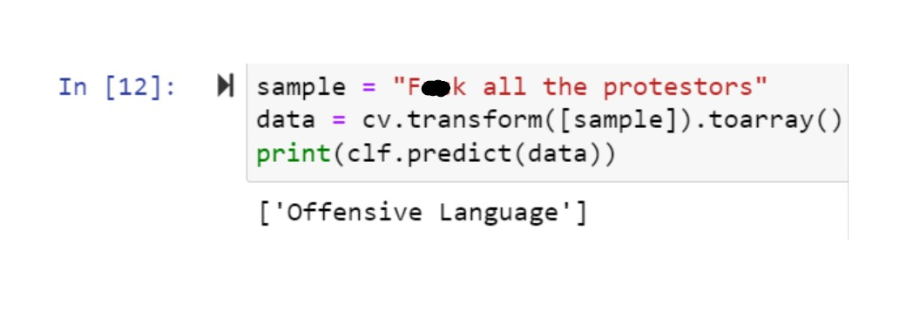

Slide 17


Slide 18
References:
Sindhu Abro, Sarang Shaikh, Zahid Hussain Khand, Zafar Ali, Sajid Khan and Ghulam Mujtaba, “Automatic Hate Speech Detection using Machine Learning: A Comparative Study” International Journal of Advanced Computer Science and Applications(IJACSA), 11(8), 2020. http://dx.doi.org/10.14569/IJACSA.2020.0110861
Kovács, G., Alonso, P. & Saini, R. Challenges of Hate Speech Detection in Social Media. SN COMPUT. SCI. 2, 95 (2021). https://doi.org/10.1007/s42979-021-00457-3
Decision Tree Algorithm by Nagesh Singh Chauhan on February 9, 2022
Data set reference: https://raw.githubusercontent.com/amankharwal/Website-data/master/twitter.csv

Slide 19


